Slide 1
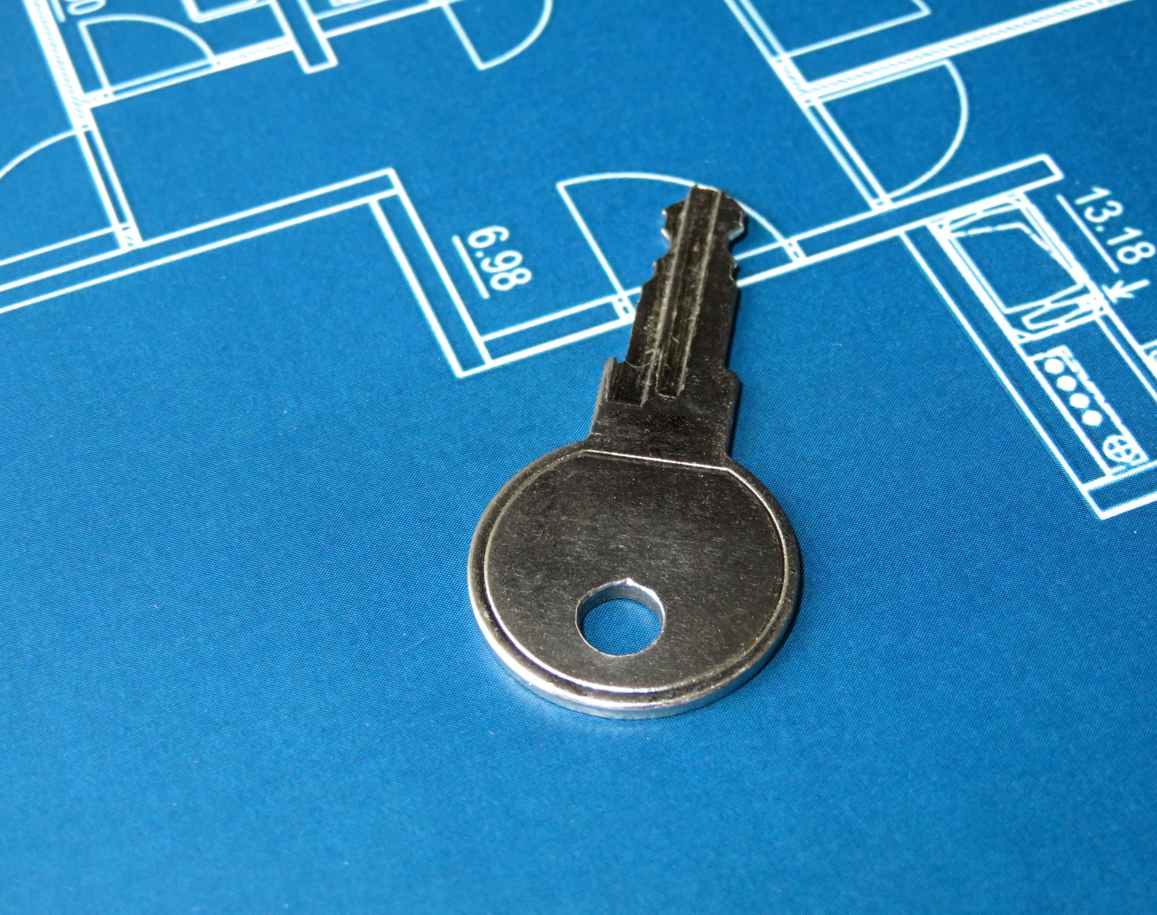
Key Technical Concept Lecture-2
By
Dr Yasir Afaq

Slide 2
Key Technical Concept:
Bit
Byte
Number system

Slide 3
What is a bit (binary digit)?
A bit (binary digit) is the smallest unit of data that a computer can process and store.
A bit is always in one of two physical states, similar to an on/off light switch. The state is represented by a single binary value, usually a 0 or 1.
However, the state might also be represented by yes/no, on/off or true/false.
Bits are stored in memory through the use of capacitors that hold electrical charges.
The charge determines the state of each bit, which, in turn, determines the bit's value.

Slide 4
What is byte?
A byte is a term first coined by Werner Buchholz in 1956 and became more of a standard thanks to Bob Bemer and others.
A byte is a unit of memory data equal to either seven or eight bits, depending on whether or not it needs error correction (parity).
You can think of a byte as one letter. For example, the letter 'h' is one byte or eight bits, and the word 'hope' is four bytes or 32 bits (4*8).

Slide 5
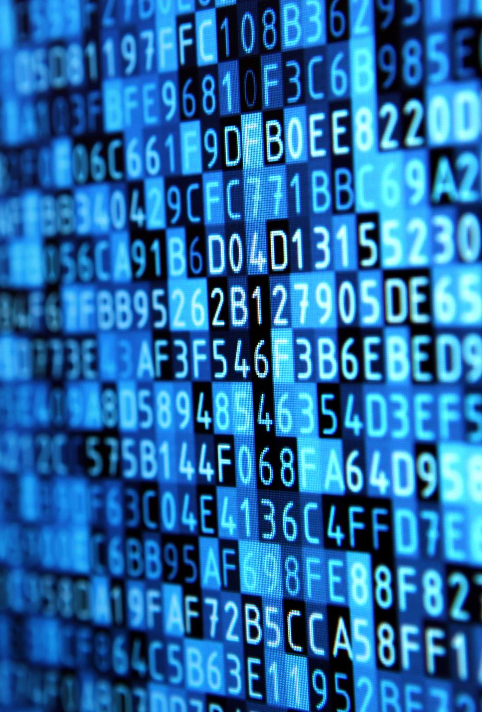
Number System and Base Conversions
Humans are used to working with decimal numbers, but computers uses machine language which is in binary, meaning that there are only 0s and 1s.
Each 0 or 1 is called a bit, and bits are organized into groups of 8 called bytes.
In the context of computers, we can define other types of number systems as follows:
Decimal number system
Binary number system
Octal number system
Hexadecimal number system

Slide 6

Decimal Number System (Base 10)
In this number system, the digits 0 to 9 represent the numbers.
As it uses 10 digits to represent a number, it is also called the base 10 number system.
Each digit has a value based on its position called place value.
The digit in the right-most position has a value of 1, and the next digit to the left has a value of 10.
Since the base is 10, each position or place has a value that is 10 times as much as the previous position, as we move from right to left.

Slide 7

Example
For example, let’s consider the decimal number 7862. In order to calculate the value of this number, we need to multiply each digit with its place value and add the resulting products.
=7 x 10³ + 8 x 10² + 6 x 10¹ + 2 x 10⁰
= 7 x 1000 + 8 x 100 + 6 x 10 + 2 x 1
= 7000 + 800 + 60 + 2
=7862

Slide 8
Binary Number System (Base 2)
A computer can understand only the “on” and “off” state of a switch. These two states are represented by 1 and 0.
The combination of 1 and 0 form binary numbers.
As only two digits are used to represent numbers, it is called a binary or base 2 number system.
Instead of representing numbers as individual units (like the number 3 0r 5000), we use groups of 1s and 0s.
The binary number system also uses positional notation.
But in this case, since the base is 2, each digit is multiplied by the appropriate power of 2 based on its position or place.

Slide 9

Example
Binary number: 1 0 1 1 0
Place Value: 2⁴ 2³ 2² 2¹ 2⁰

Slide 10
Octal Number System (Base 8)
This system uses digits 0 to 7 (i.e. 8 digits) to represent a number. The octal system groups binary numbers into triplets.
So, the octal system is base-8, since 2³ = 8. So, the place values will be ascending in powers of 8 from right to left.

